Slide 1
USER PROFILE MATCHING IN SOCIAL NETWORKS
FINAL REPORT

Slide 2
GROUP 13
CB.EN.U4CSE17014 | CH. SAI PHANI JASWANTH
CB.EN.U4CSE17043 | NANDITHA MENON
CB.EN.U4CSE17049 | RISHI VIGNESH
CB.EN.U4CSE17065 | T. SAI SRIHITHA REDDY

Slide 3
INTRODUCTION

Slide 4
INTRODUCTION
The rapid growth in the number of users using social networks and the information that a social network requires about their users make the traditional matching systems insufficiently adept at matching users within social networks.
Social networking sites, especially online dating sites, maintain a user profile database to match a user with others who have similar preferences and tastes. The users specify specific criteria, based on which their profiles are matched with that of other users.
We plan to use Clustering algorithms to find users that are most similar to each other and recommend dating profiles the same way Spotify or Netflix recommends different music and movies. By using the clustering algorithm like k-means, we can reduce the number of profiles to be compared in the knn clustering algorithm.

Slide 5
ALGORITHMS USED
K-MEANS
HIERARCHICAL CLUSTERING
DBSCAN
KNN

Slide 6
PROBLEM STATEMENT
To recommend k similar profiles to a user based on the personal information provided through the survey.

Slide 7
OBJECTIVE
To cluster the users into various groups
To apply knn on each cluster to find k nearest profiles for a user
To apply knn on the whole dataset to find k nearest profiles for a user

Slide 8
NOVELTY
Clustering the users reduces the size of the dataset passed into the knn algorithm. This in turn leads to reduced execution time while finding k nearest neighbours of the current node.
Clustering can also provide deeper insights into the users through clusters and related cluster analysis.

Slide 9
METHOD
Generating dataset
Analysing the data
Preprocessing the data
Applying clustering algorithms
Recommend top 5 similar profiles

Slide 10
ALGORITHM
Apply clustering to create clusters of users with similar profiles
Use knn clustering to find top k profiles identical to the user
Compare the results with when knn is performed on the whole dataset

Slide 11
DATA COLLECTION AND PREPARATION

Slide 12
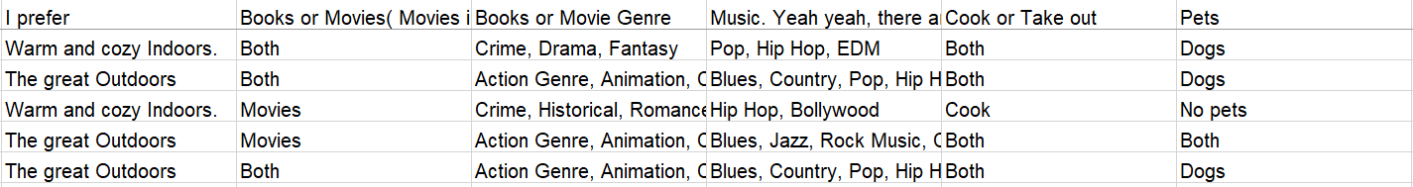
DATASET
Columns - Timestamp, Email Address, Name, Age, Zodiac, Gender, Character, Preference, TV Show Genres, Music Genres, Food, Pets

Slide 13
DATA CLEANING

Slide 14
The dataset is cleaned by renaming the columns into
And dropping duplicate entries based on the email column -

Slide 15
EXPLORATORY DATA ANALYSIS

Slide 16
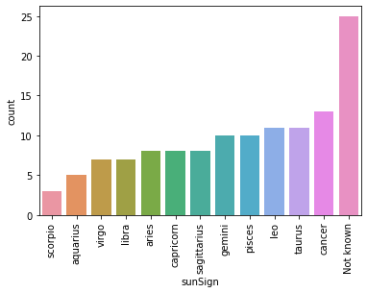
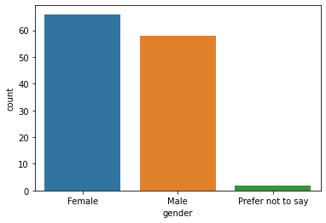
COUNT PLOT ON GENDER
COUNT PLOT ON ZODIAC SIGNS

Slide 17
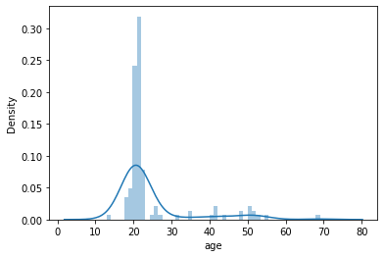
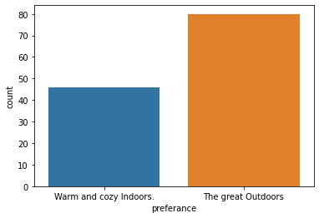
AGE DISTPLOT
COUNT PLOT ON OUTDOOR VS INDOOR PREFERENCE

Slide 18
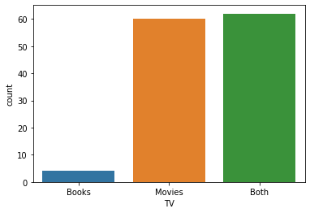
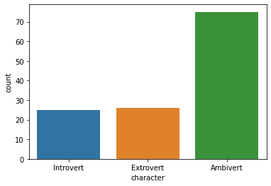
TV PREFERENCE COUNT PLOT
CHARACTER COUNT PLOT

Slide 19
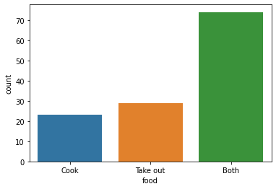
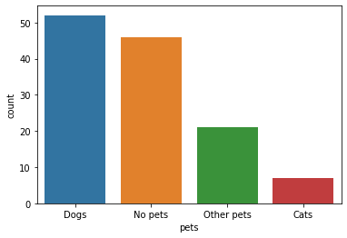
PET PREFERENCE
FOOD PREFERENCE COUNT PLOT

Slide 20
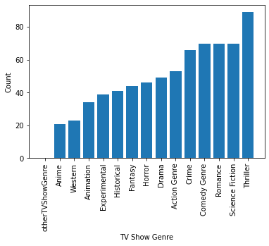
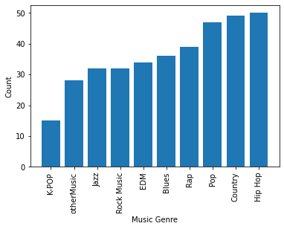
TV SHOW GENRE PREFERENCE
MUSIC GENRE PREFERENCE

Slide 21
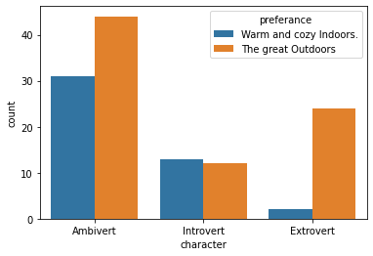
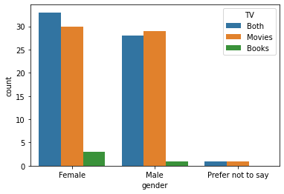
PLOTTING CHARACTER AGAINST OUTDOOR VS INDOOR PREFERENCE
PLOTTING GENDER AGAINST TV PREFERENCES

Slide 22
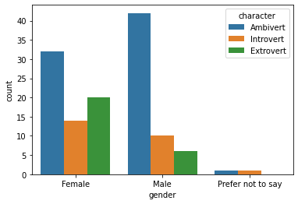
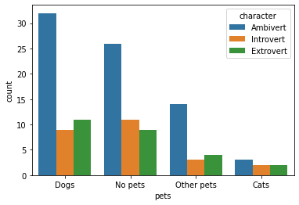
PLOTTING PETS AGAINST CHARACTER
PLOTTING GENDER AGAINST CHARACTER

Slide 23
DATA PREPROCESSING

Slide 24
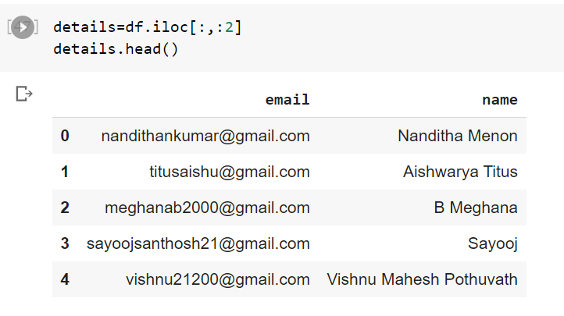
Convert all the categorical values into binary value columns using get_dummies function and label_encoder from sklearn.preprocessing.
Store the name and email details in a separate data frame.
Normalize the age to between 0 and 1 using MinMaxScaler from sklearn.preprocessing.

Slide 25
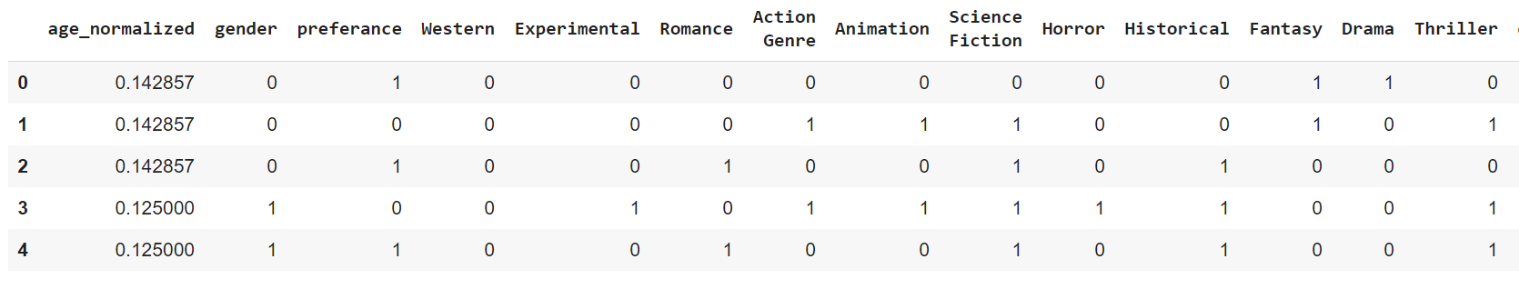
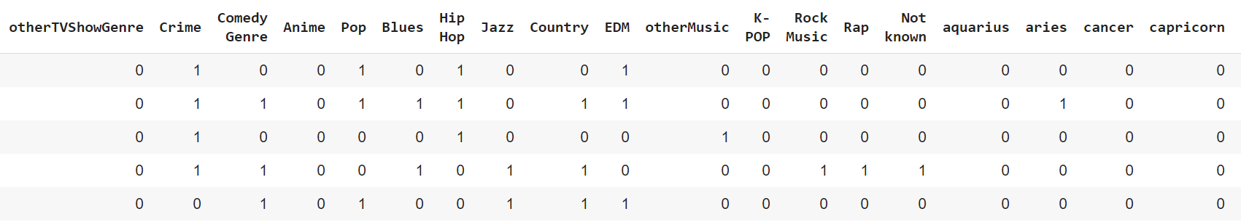
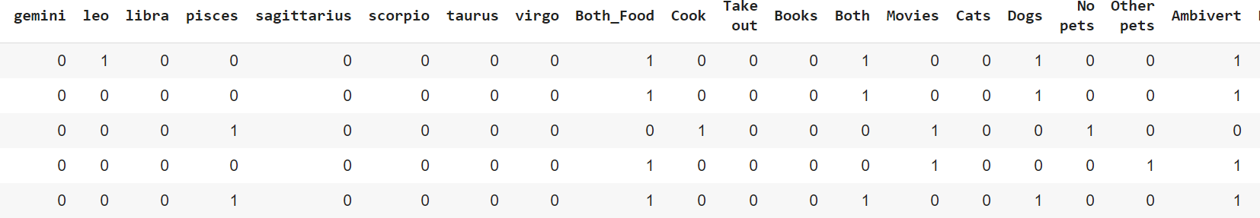
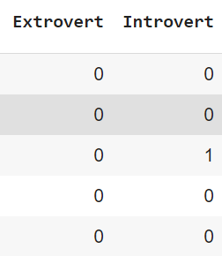

Slide 26
COLLINEARITY CHECK

Slide 27
When variables used in clustering have strong correlation, some variables get a higher weight than others. If two variables are perfectly correlated, they effectively represent the same concept.
But that concept is now represented twice in the data and hence gets twice the weight of all the other variables.
The final solution is likely to be skewed in the direction of that concept, which could be a problem if it’s not anticipated.

Slide 28
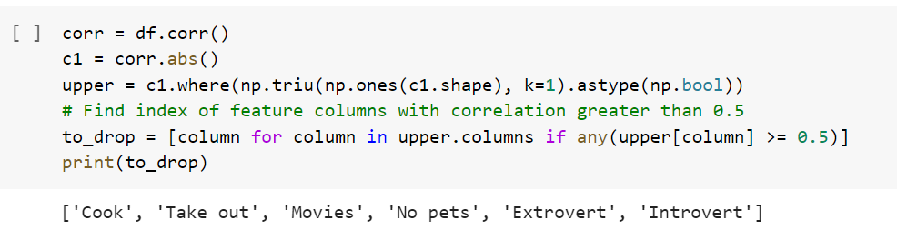
The columns - ['Cook', 'Take out', 'Movies', 'No pets', 'Extrovert', 'Introvert'] have correlation coefficients more than 0.5, making them columns with strong collinearity.
Drop the columns from the dataset.

Slide 29
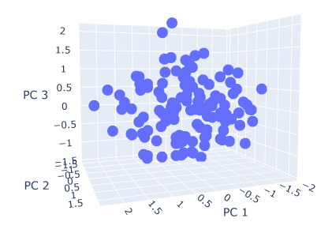
REDUCING DIMENSIONALITY (WITH PCA)

Slide 30
IMPLEMENTING CLUSTERING ALGORITHMS

Slide 31
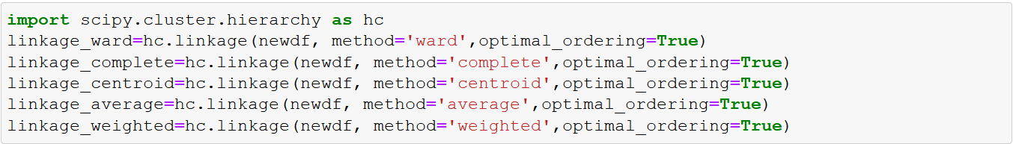
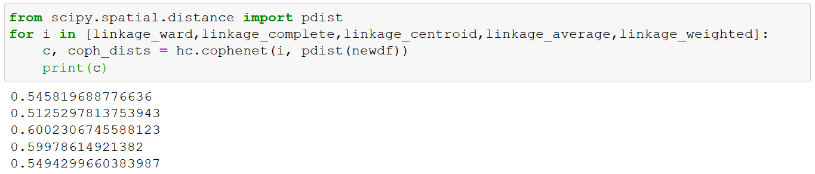
HIERARCHICAL CLUSTERING
Notes:
Hierarchical clustering has many methods: ward, complete, centroid, average, weighted, etc. To find the best method for the current dataset we use cophenetic distance to compare these methods. Centroid method linkage seems to provide the highest cophenetic distance. Using this method a dendrogram is drawn.
The scipy.cluster.hierarchy library has linkage and dendrogram functions which can be used to plot the clustering.
To choose the number of clusters, a horizontal line is drawn through 2 clusters which are the most farther from each other. In the below dendrogram, such a horizontal line passes through 4 vertical lines. So the apt number of clusters for the given data is 4!

Slide 32
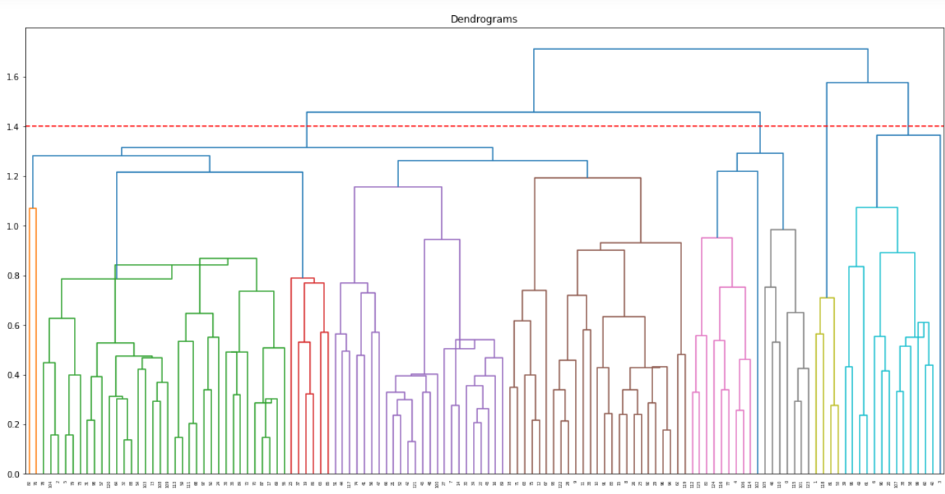
DENDROGRAM FORMED FROM CENTROID LINKAGE FOR THE DATASET APT. NO OF CLUSTERS =4

Slide 33
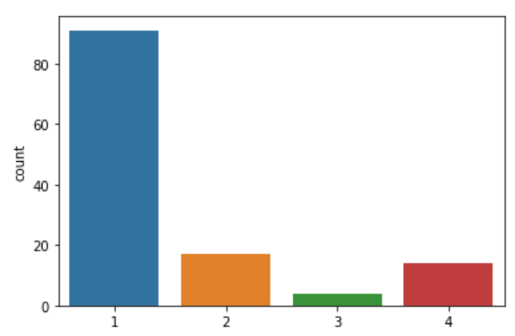
HIERARCHICAL CLUSTERING LABELS
COUNT PLOT ON LABELS OF CLUSTERS

Slide 34
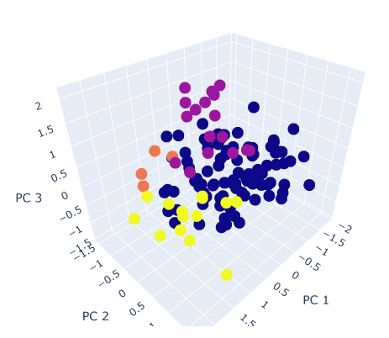
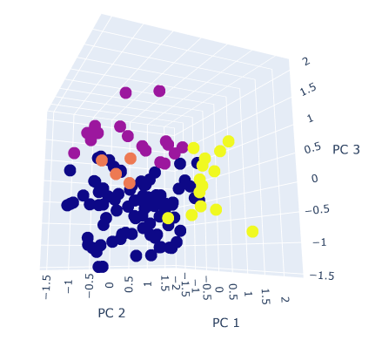
Using PCA to reduce the dimensions and plotting the nodes in a 3D map colored by the labels obtained.

Slide 35
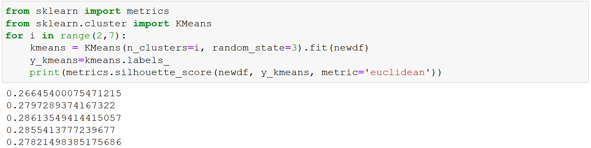
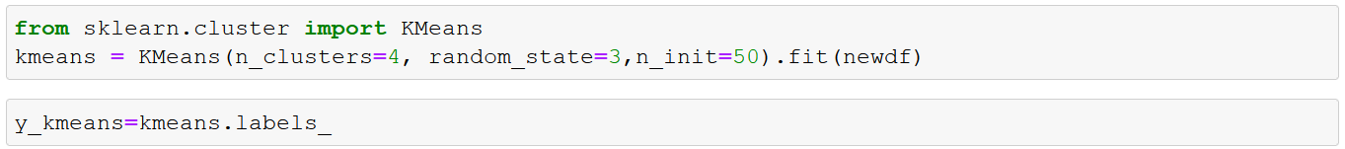
K-MEANS
Silhouette score is used to find the best k for kmeans. The sklearn.cluster library provides KMeans.

Slide 36
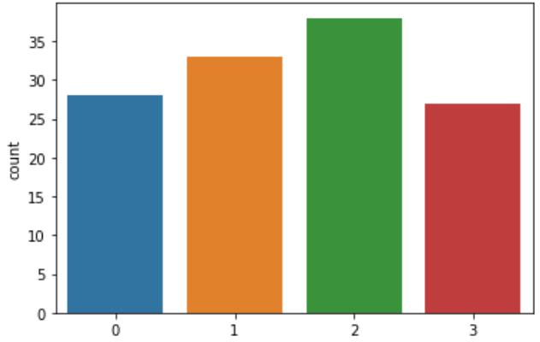
K-MEANS LABELS
COUNT PLOT ON LABELS OF CLUSTERS

Slide 37
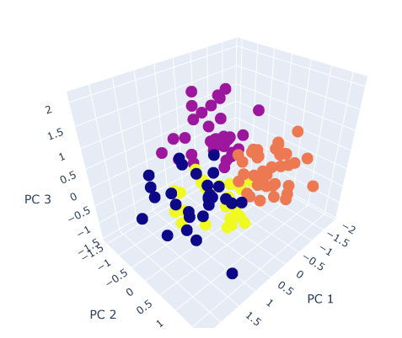
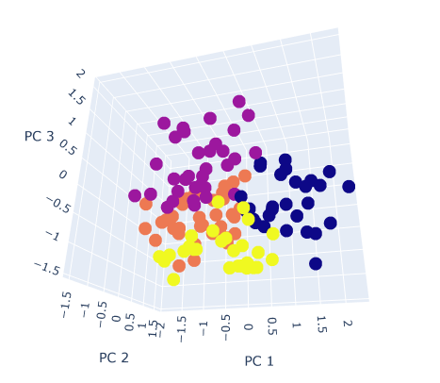
Using PCA to reduce the dimensions and plotting the nodes in a 3D map colored by the labels obtained.

Slide 38
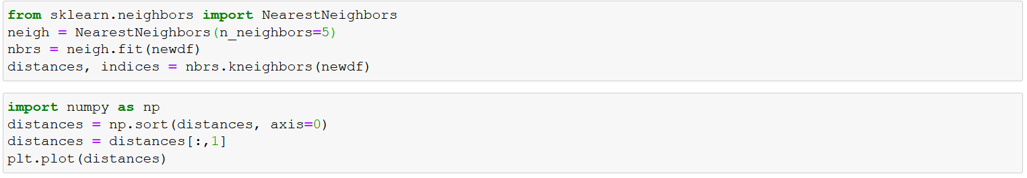
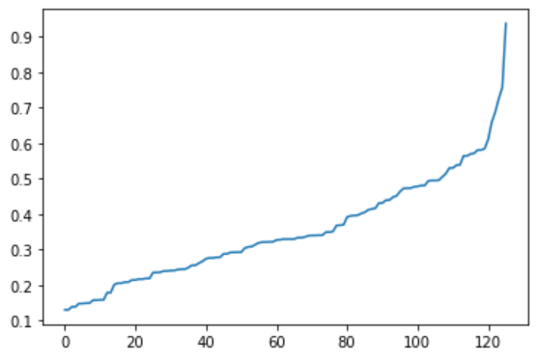
DBSCAN
The maximum curvature point can be seen at 0.6, so epsilon will be 0.6

Slide 39
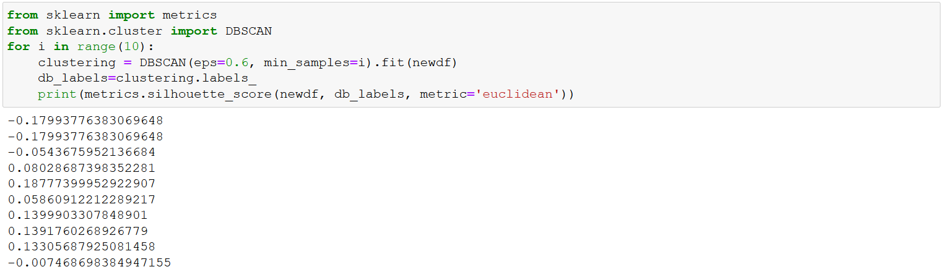
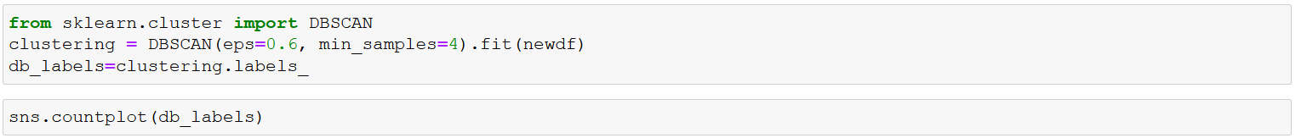
Best min_samples score decided according to silhouette score. Optimized value - 4

Slide 40
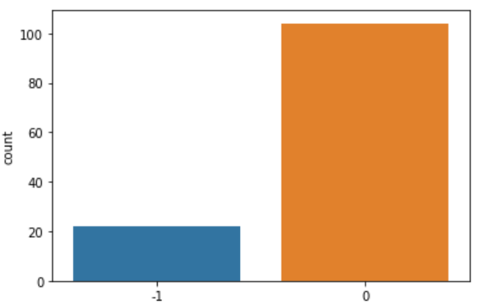
DBSCAN LABELS
The above countplot indicates that more than 20 profiles have been classified as noise data. All the remaining nodes have been put into one cluster
COUNT PLOT ON LABELS OF CLUSTERS

Slide 41
PERFORMANCE EVALUATION

Slide 42
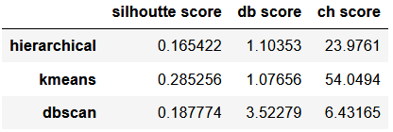
EVALUATION METRICS
DBSCAN- not an apt choice for clustering anymore.
K-means gives better results for all evaluation metrics.

Slide 43
APPLYING KNN

Slide 44
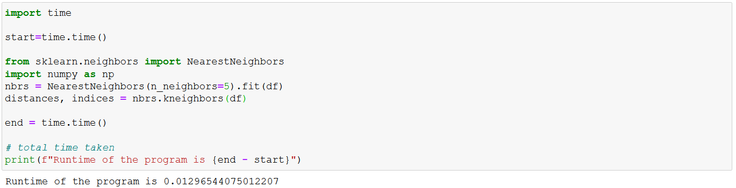
ON WHOLE DATASET

Slide 45
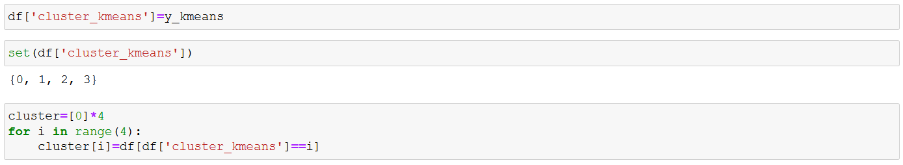
KNN ON SEPARATE CLUSTERS
KNN is performed on both the clusters separately again the same way it was performed on the whole dataset.

Slide 46
RESULTS

Slide 47
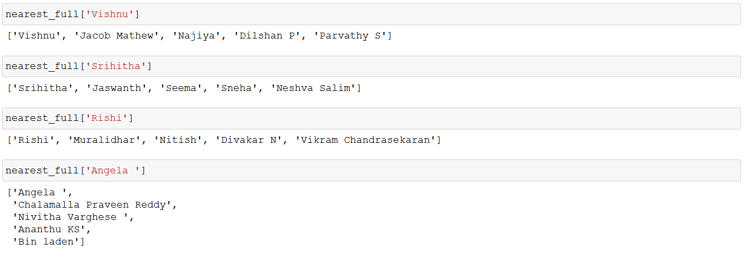
For whole dataset -

Slide 48
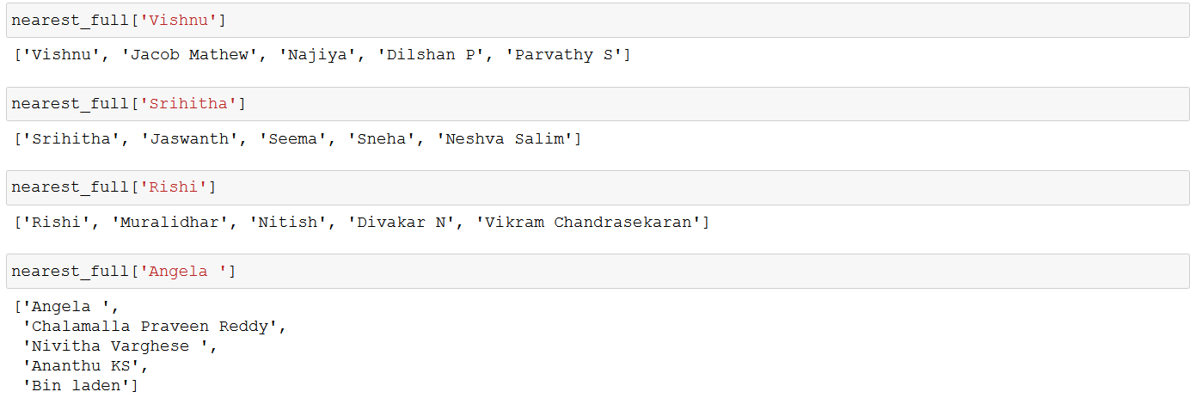
Cluster wise results for same nodes -

Slide 49
DISCUSSION

Slide 50
Time taken for KNN to be performed on whole dataset of appx. 130 rows - 0.013sec
Time taken for KNN on each cluster - 0.004sec on average
KNN only needs to be applied for that particular cluster and not whole dataset.
The downside of clustering - the nodes near the edge might suffer from variation in predictions if the clusters are not far enough.

Slide 51
CONCLUSION

Slide 52
CONCLUSION
The dataset acquired has been preprocessed and K-Means Clustering has been applied on it.
KNN results of cluster-wise data frames and whole dataset have also been explored visually as well as through evaluation metrics.

Slide 53
FUTURE ENHANCEMENTS
Currently only MCQ type responses.
Adding columns with descriptive text sentences the users will be able to express themselves more.
Might be able to provide more clear results in terms of clustering as well as analysis of the clusters.

Slide 54
REFERENCES
Survey of Clustering Data Mining Techniques
Online Dating Recommendations: Matching Markets and Learning Preferences
https://towardsdatascience.com/hierarchical-clustering-in-python-using-dendrogram-and-cophenetic-correlation-8d41a08f7eab
https://towardsdatascience.com/machine-learning-clustering-dbscan-determine-the-optimal-value-for-epsilon-eps-python-example-3100091cfbc
https://iopscience.iop.org/article/10.1088/1755-1315/31/1/012012/pdf

